Slide 1

DataWarehouse – Foundations of Datwarehousing

Slide 2
Roadmap
Data Warehousing - An Overview
OLAP vs OLTP
Date Warehouse Architecture
Data Marts
Data Mining
Facts
Dimensional Model
SCD Types – 1,2,3
Facts
Fact Types
Data Cleansing and Profiling
ETL – Extract, Transform and Load
BI introduction
Cloud

Slide 3

What is a Data Warehouse ?
Can I see credit report from Accounts, Sales from marketing and open order report from order entry for this customer
Data from multiple sources is integrated for a subject
A data warehouse is a subject-oriented, integrated, nonvolatile,
time-variant collection of data in support of management's decisions.
- WH Inmon
Identical queries will give same results at different times. Supports analysis requiring historical data
Data stored for historical period. Data is populated in the data warehouse on daily/weekly basis depending upon the requirement.

Slide 4
Subject-Oriented
Data is arranged and optimized to provide answer to questions from diverse functional areas
Data is organized and summarized by topic
Sales / Marketing / Finance / Distribution / Etc.
Integrated
The data warehouse is a centralized, consolidated database that integrated data derived from the entire organization
Multiple Sources
Diverse Sources
Diverse Formats

Slide 5

Time-Variant
The Data Warehouse represents the flow of data through time
Can contain projected data from statistical models
Data is periodically uploaded then time-dependent data is recomputed
Nonvolatile
Once data is entered it is NEVER removed
Represents the company’s entire history
Near term history is continually added to it
Always growing
Must support terabyte databases and multiprocessors
Read-Only database for data analysis and query processing

Slide 6
Need for Data Warehousing
Better business intelligence for end-users
Reduction in time to locate, access, and analyze information
Consolidation of disparate information sources
Strategic advantage over competitors
Faster time-to-market for products and services
Replacement of older, less-responsive decision support systems
Reduction in demand on IS to generate reports
Who are the potential Customers ?
Which Products are sold the most ?
What are the region-wise preferences ?
What are the competitor products ?
What will be the impact on revenue ?
Results of promotion schemes introduced ?
What are the projected sales ?
What if you sale more quantity of a particular product ?
Need of Intelligent Information in Competitive Market

Slide 7
12 Rules of a Data Warehouse
Data Warehouse and Operational Environments are Separated
Data is integrated
Contains historical data over a long period of time
Data is a snapshot data captured at a given point in time
Data is subject-oriented
Mainly read-only with periodic batch updates
Development Life Cycle has a data driven approach versus the traditional process-driven approach
Data contains several levels of detail
Current, Old, Lightly Summarized, Highly Summarized
Environment is characterized by Read-only transactions to very large data sets
System that traces data sources, transformations, and storage
Metadata is a critical component
Source, transformation, integration, storage, relationships, history, etc
Contains a chargeback mechanism for resource usage that enforces optimal use of data by end users

Slide 8
OLTP vs Data Warehouse
OLTP | WAREHOUSE (DSS)
Application Oriented Used to run business Detailed data Current data Isolated Data Repetitive access Clerical User | Subject Oriented Used to analyze business Summarized and refined Snapshot data Integrated Data Ad-hoc access Knowledge User (Manager)

Slide 9
OLTP vs Data Warehouse
OLTP | WAREHOUSE (DSS)
Performance Sensitive Few Records accessed at a time (tens) Read/Update Access No data redundancy Database Size - Small | Performance relaxed Large volumes accessed at a time(millions) Mostly Read (Batch Update) Redundancy present Database Size- Large

Slide 10
Complete Data Warehouse Architecture Solution
Data
Information
Knowledge
Data Sources
Data Management
Access
Sales
Data Mart
Metadata
Legacy Data
Inventory
Extract
Transform
Load
Enterprise
Data Warehouse
Data Mart
Operational Data
Purchase
The Post
Data Mart
VISA
External Data Sources
Organizationally structured
Departmentally structured
Asset Assembly (and Management)

Slide 11
OLAP
4 Main Characteristics
Multidimensional data analysis
Advanced Database Support
Easy-to-use end-user interfaces
Support Client/Server architecture
Multidimensional Data Analysis Techniques :
Advanced Data Presentation Functions
3-D graphics, Pivot Tables, Crosstabs, etc.
Compatible with Spreadsheets & Statistical packages
Advanced data aggregations, consolidation and classification across time dimensions
Advanced computational functions
Advanced data modeling functions

Slide 12
OLAP
Advanced Data Access Features
Access to many kinds of DBMS’s, flat files, and internal and external data sources
Access to aggregated data warehouse data
Advanced data navigation (drill-downs and roll-ups)
Ability to map end-user requests to the appropriate data source
Support for Very Large Databases

Slide 13
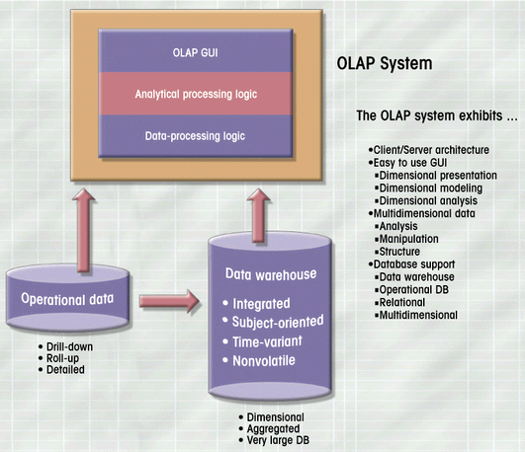
OLAP Architecture

Slide 14
Operational Data Store - ODS
What is an ODS ?
An Operational Data Store (ODS) integrates data from multiple business operation sources to address operational problems that span one or more business functions. The ODS provides an integrated view of data in operational systems.
As the figure below indicates, there is a clear separation between the ODS and the data warehouse.
A
Operational Data Store
Data Warehouse
EIS
DSS
B
Apps
PC
C
Historical data
Current or near
current data
Summary
Detailed data
Non-volatile
Updates allowed
Snapshots only

Slide 15
Data Marts
Small Data Stores
More manageable data sets
Targeted to meet the needs of small groups within the organization
Small, Single-Subject data warehouse subset that provides decision support to a small group of people
Enterprise wide data warehousing projects have a very large cycle time
Getting consensus between multiple parties may also be difficult
Departments may not be satisfied with priority accorded to them
Sometimes individual departmental needs may be strong enough to warrant a local implementation
Application/database distribution is also an important factor

Slide 16
Data Mart Overview
DM Sales
Sales Representatives
DM Sales
and Analysts
Data Warehouse
DM Marketing
DM HR
DM HR
DM Sales
DM HR
Human
DM Finance
Resources
Data Marts
DM Marketing
Satisfy 80% of
Financial Analysts,
the local end-
Strategic Planners,
users’ requests
and Executives

Slide 17
Data Mining
Discover Previously unknown data characteristics, relationships, dependencies, or trends
Typical Data Analysis Relies on end users
Define the Problem
Select the Data
Initial the Data Analysis
Reacts to External Stimulus
Proactive
Automatically searches
Anomalies
Possible Relationships
Identify Problems before the end-user
Data Mining tools analyze the data, uncover problems or opportunities hidden in data relationships, form computer models based on their findings, and then user the models to predict business behavior – with minimal end-user intervention
A methodology designed to perform knowledge-discovery expeditions over the database data with minimal end-user intervention
3 Stages of Data
Data
Information
Knowledge

Slide 18
4 Phases of Data Mining
Data Preparation
Identify the main data sets to be used by the data mining operation (usually the data warehouse)
Data Analysis and Classification
Study the data to identify common data characteristics or patterns
Data groupings, classifications, clusters, sequences
Data dependencies, links, or relationships
Data patterns, trends, deviation
Knowledge Acquisition
Uses the Results of the Data Analysis and Classification phase
Data mining tool selects the appropriate modeling or knowledge-acquisition algorithms
Neural Networks
Decision Trees
Rules Induction
Genetic algorithms
Memory-Based Reasoning
Prognosis
Predict Future Behavior
Forecast Business Outcomes
65% of customers who did not use a particular credit card in the last 6 months are 88% likely to cancel the account.

Slide 19
Overview of Schemas
A schema is a collection of database objects, including tables, views, indexes, and synonyms.
There is a variety of ways of arranging schema objects in the schema models designed for data warehousing.
Star Schema
Snowflake Schema
Galaxy Schema

Slide 20
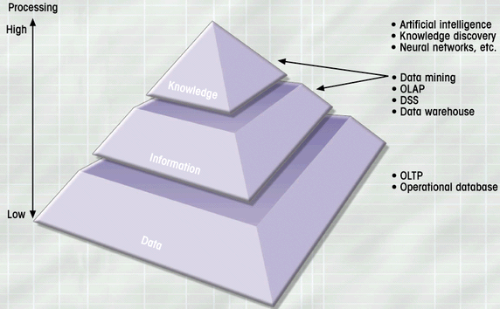
Extraction of Knowledge from Data – Building Insights

Slide 21
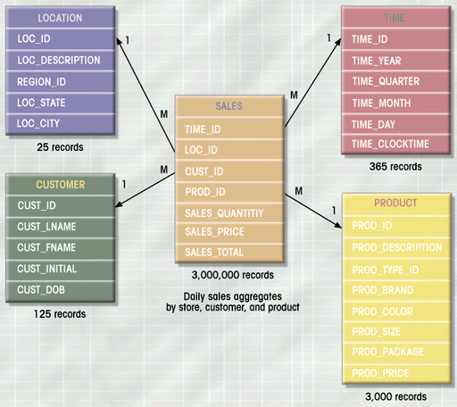
Star Schema
A star schema a highly De-Normalized, query-centric model where information is broken into two groups: facts and dimensions.

Slide 22
Snowflake Schema
The snowflake schema is represented by centralized fact tables which are connected to multiple dimensions.
The purpose of a snowflake schema is to normalize the denormalized data in a star schema.
Sales_fact
timeID {FK}
propertyID {FK}
branchID {FK}
clientID {FK}
promotionID {FK}
staffID {FK}
ownerID {FK}
offerPrice
sellingPrice
saleCommission
saleRevenue
Branch_Dim
branchID {PK}
branchNo
branchType
city {FK}
City
city {PK}
region {FK}
Region
region {PK}
country
Fact Table
Dimension Tables

Slide 23
Galaxy Schema
A Galaxy Schema contains two fact table that share dimension tables between them. It is also called Fact Constellation Schema.
The design involves more than one fact table, which are connected further with multiple dimension tables that are completely normalized.
Dimension1
Dimension2
Fact1
Dimension3
Dimension4
Fact2
Dimension5
Fact3
Dimension6
Dimension7

Slide 24
Facts
Numeric measurements (values) that represent a specific business aspect or activity
Stored in a fact table at the center of the star scheme
Contains facts that are linked through their dimensions
Can be computed or derived at run time
Updated periodically with data from operational databases

Slide 25
Fact Types
Additive facts:
Additive facts are facts that can be summed up through all of the dimensions in the fact table
Semi-Additive facts:
Semi-additive facts are facts that can be summed up for some of the dimensions in the fact table
Non-additive facts:
Non-additive facts are facts that cannot be summed up for any of the dimensions Present in the fact table

Slide 26
Dimensions
Qualifying characteristics that provide additional perspectives to a given fact
DSS data is almost always viewed in relation to other data
Dimensions are normally stored in dimension tables
A dimension is a structure that categorizes facts and measures in order to enable users to answer business questions. Commonly used dimensions are people, products, place and time. In a data warehouse, dimensions provide structured labeling information to otherwise unordered numeric measures.

Slide 27
Dimension Table Types
Slowly Changing dimensions
Junk Dimensions
Conformed Dimensions
Degenerated Dimensions

Slide 28
Degenerated Dimension
Degenerate dimension is a dimension which is derived from the fact table and doesn't have its own dimension table.
Degenerate dimensions are often used when a fact table's grain represents transactional level data and one wishes to maintain system specific identifiers such as order numbers, invoice numbers and the like without forcing their inclusion in their own dimension.

Slide 29
Conformed Dimension
A conformed dimension is a dimension that has the same meaning to every fact with which it relates.
Conformed dimensions allow facts and measures to be categorized and described in the same way across multiple facts and/or data marts, ensuring consistent reporting across the enterprise.

Slide 30
Junk Dimension
A dimension where one can store random transactional codes, flags and text attributes that are not related to other dimensions and which provides a simple way for users to easily find those unrelated attributes.
Ex: Martial Status : (Yes or No)
Gender : (M or F) etc.

Slide 31


Slowly Changing Dimensions Type 1
The first picture depicts the state of SCD before change
In type 1 SCD the existing row in the dimension table is updated with the new value
Note the fact that the product key has not changed even if the department changes
What are the advantages of SCD Type 1?
Easy to implement the change in attribute is easy – Simple update.
What are the disadvantages of SCD Type 1?
We will lose all history of attribute changes
The company decides to change the department

Slide 32

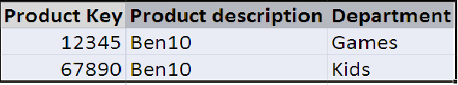
Slowly Changing Dimensions Type 2
The scenario remains the same as in SCD Type1 – It company decided to change the department of a product.
One of the primary goals of the data warehouse was to represent prior history correctly
SCD Type 2 does exactly the same. A new dimension row is introduced.
This new row will reflect the new department attribute value.
The type 2 response is the primary technique for accurately tracking slowly changing dimension attributes.
It is extremely powerful because the new dimension row automatically partitions history in the fact table.
It certainly would feel natural to include an effective date stamp on a dimension row with type 2 changes
The date stamp would refer to the moment when the attribute values in the row become valid or invalid.

Slide 33

Slowly Changing Dimensions Type 3
The scenario remains the same as in SCD Type1 – It company decided to change the department of a product.
Some users may still want the ability to see today’s sales in terms of yesterday’s district lines
This is to see how they would have done under the old organizational structure
Lets go back to our old example
There is a legitimate need to track both the values both forward and backward for a period of time around the change we do not issue a new dimension row. We add a new column to capture the attribute change
Type 3 is appropriate when there’s a strong need to support two views of the world simultaneously
This is distinguished from the type 2 because both the current and prior descriptions can be regarded as true at the same time

Slide 34
ETL – Extract, Transform and Load
Data Extract
Get Data from source
Data Transformation
Data Cleansing - Data Quality Assurance
Data Scrubbing - Removing errors and inconsistencies
Processing Calculations
Applying Business Rules
Changing Data Types
Making the Data More Readable
Replacing Codes with Actual Values
Summarizing the Data
Data Load
Load data into Warehouse

Slide 35
Extraction
The first part of the ETL process.
Data under consideration is being extracted from the different data sources.
The source data may use a different data organization/format.
Some of the common data sources are :
Databases
Flat files

Slide 36
Transform
It involves applying a series of rules to the data extracted from the source to derive the data to load the target.
Depending on the requirement of the target, the transformation rules may be simple or complex.
Transformation may involve :
Selecting only certain columns to load
Filtering
Sorting
Combining data from multiple sources
Generating Surrogate keys, etc.

Slide 37
Load
The last step of the ETL process
The load phase loads the transformed data to the end target.
Depending on the requirement, the load phase may be:
Full Load
Incremental Load

Slide 38
Importance of ETL
Data of an organization spread across multiple geographies and domains.
Data organized in different format in different sources.
Consolidation of the data to make it more meaningful.
Applying Business rules enriches the value the data provides.
Identifying the inconsistencies and providing a unified view.
Improving the data quality.

Slide 39
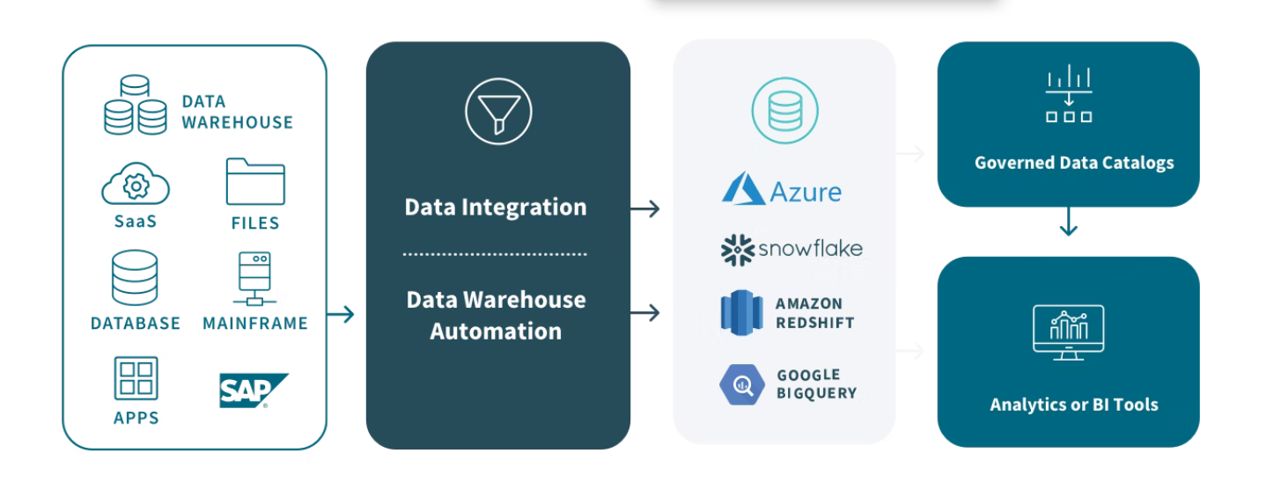
Impact of Cloud in Datawarehousing
Cloud storage and processing for data science and analytics arose due to the costs and requirements of storing and processing the ever-increasing amount of data on earth
A cloud data warehouse is a database stored as a managed service in a public cloud and optimized for scalable BI and analytics.
Benefits
Faster Insights
Scalability
Overhead

